Slide 1
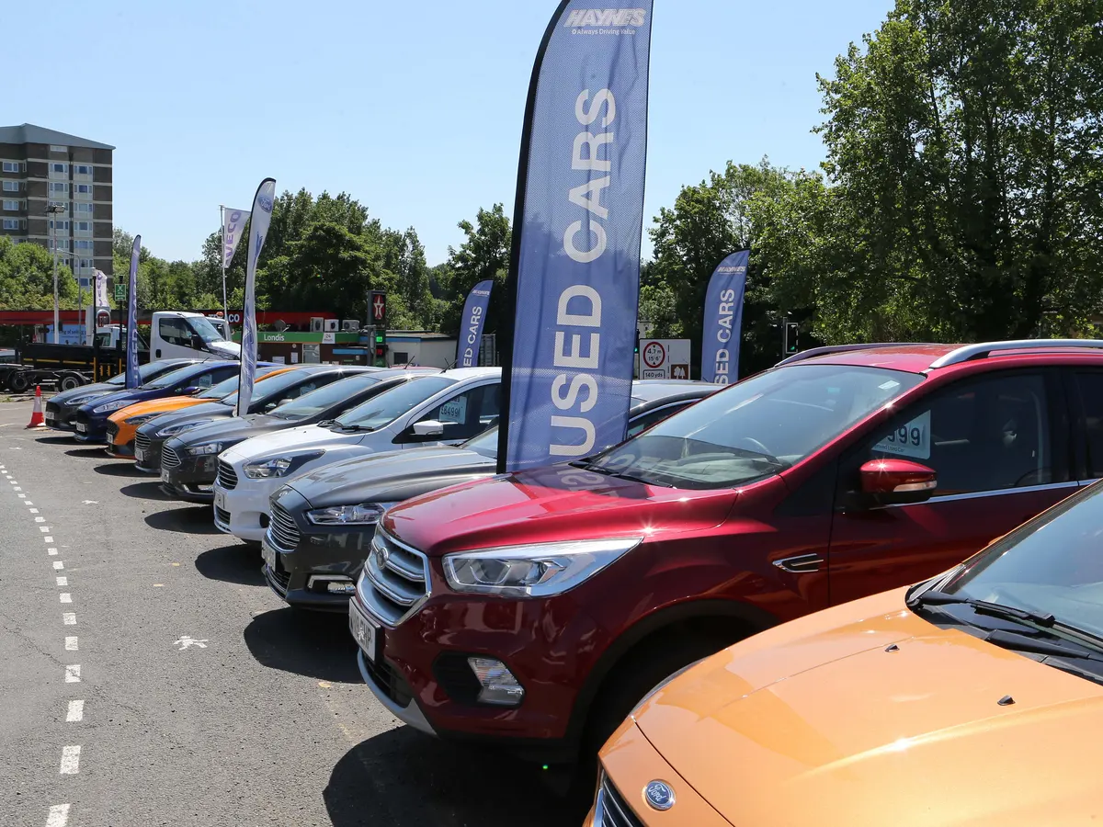
Subject : Identifying the most important feature for the sale of used cars
Adjective : Visualize how the sales and price of the used cars influenced by the different feature based on our dataset. Data visualization techniques that are going to be used in this project are filters, bins and forecast the future sales
Description of the Data : The dataset contains 75k rows and 14 columns. The dataset shows us how many used cars have been sold from 1942 to 2022 with their prices.
High Level Plan for the Week :
DAY 1 : EDA ( rename columns, lowercase, drop unwanted columns, filling NA, finding nulls, cleaning the rows and the names, unique values, unique counts, removing the outliers, standardize the data)
DAY 2 : Data cleaning, removing the wrong data types, checking the correlation between the input features
DAY 3 : Create the dashboard
DAY 4 : Presentation Preparation
Project Title: Analysis of Used car in Pakistan Market
Group Members : Nandhini Natrayan
Yaren Merve Akin

